Slide 1
Task 28 Status Report
The Social Science of Wind Energy Acceptance
Suzanne Tegen, NREL and Garry Keegan, IPC
18 May 2022

Slide 2
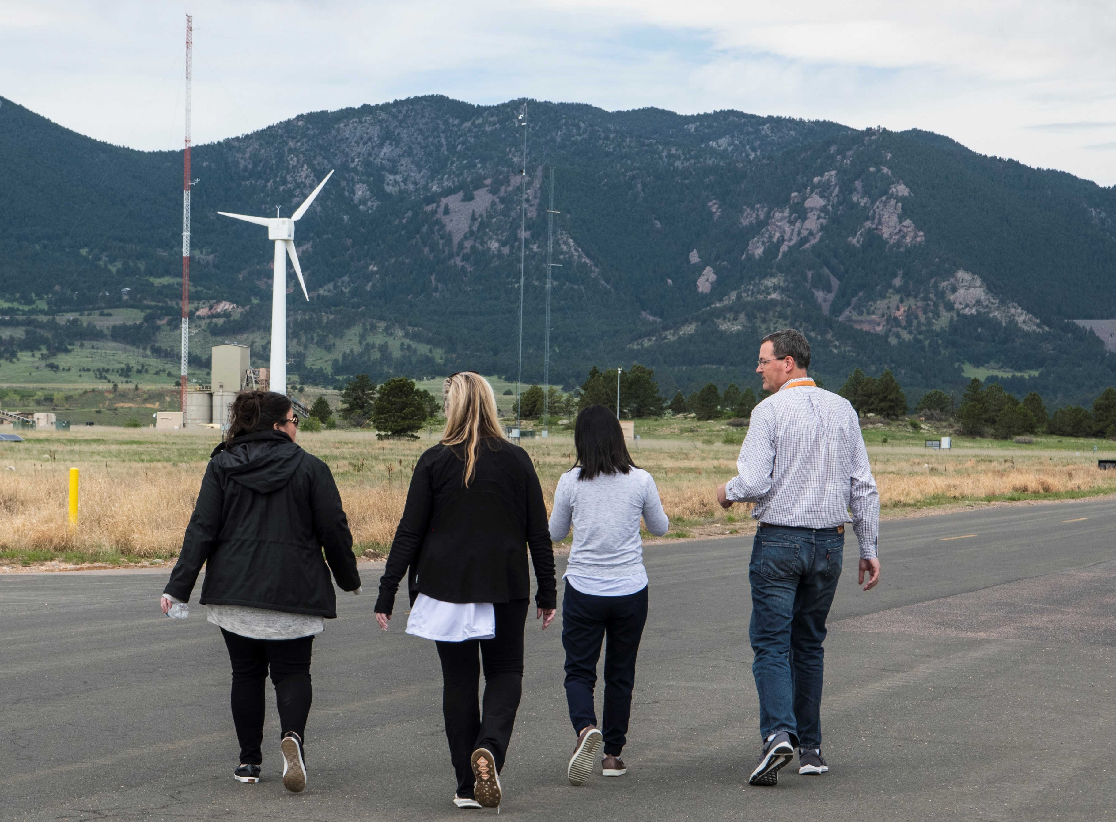
Task Objectives & Expected Results
Objectives and Outcomes:
    Ensuring diverse participation from a larger number of countries and a variety of researchers and social scientists interested in the responsible and appropriate deployment of wind projects;
    Adopting new methods of knowledge sharing based on more proactive involvement of Task participants;
    Maximising the value of the Task outputs through engagement of end users and broad systems thinking;
    Exploration of increasing the Task’s reach to emerging economies and to help with the global energy transition;
Current Term May 2020 – April 2024
Photo Credit: Dennis Schroeder, NREL

Slide 3
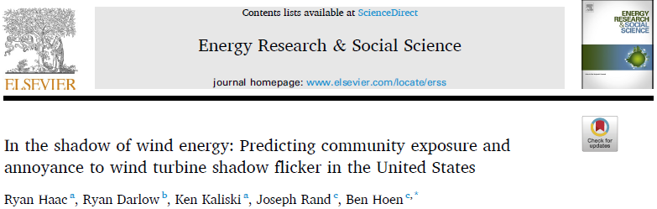
Technical Results
Shadow flicker (SF) was modeled at ~35,000 residences surrounding US wind turbines, including 747 survey respondent homes.
Modeled SF exposure strongly predicted if a respondent perceived SF in their home.
Higher modeled SF exposure levels did not lead to higher levels of self-reported annoyance to SF.
  Instead, self-reported SF annoyance was correlated with subjective factors, e.g., project appearance and general annoyance.
  Current Work and Recent Publications
New Research from NL, UK, US, and DK: Wind Energy Impacts on Residential Property Values
Social Impacts of Turbine Scaling: Then vs. Now vs. Future (US)
Brunner, E., Hoen, B., & Hyman, J. (2022). School district revenue shocks, resource allocations, and student achievement: Evidence from the universe of US wind energy installations. Journal of Public Economics.

Slide 4
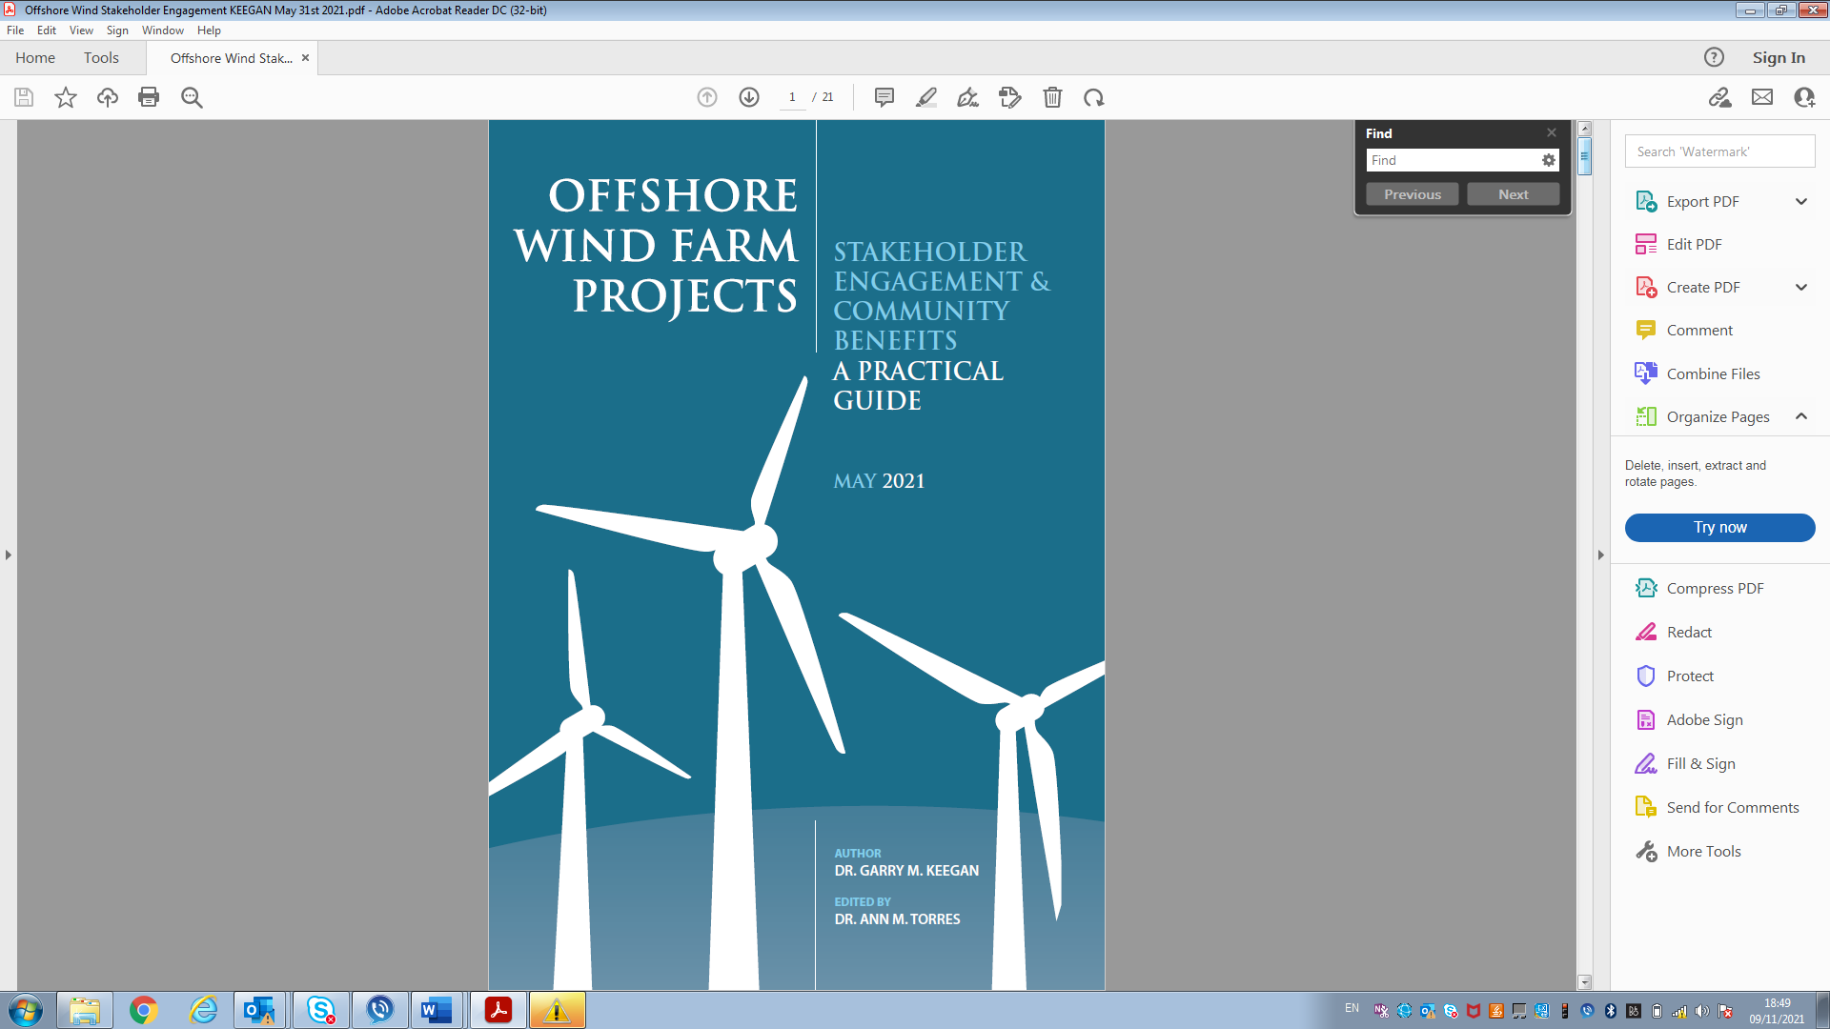
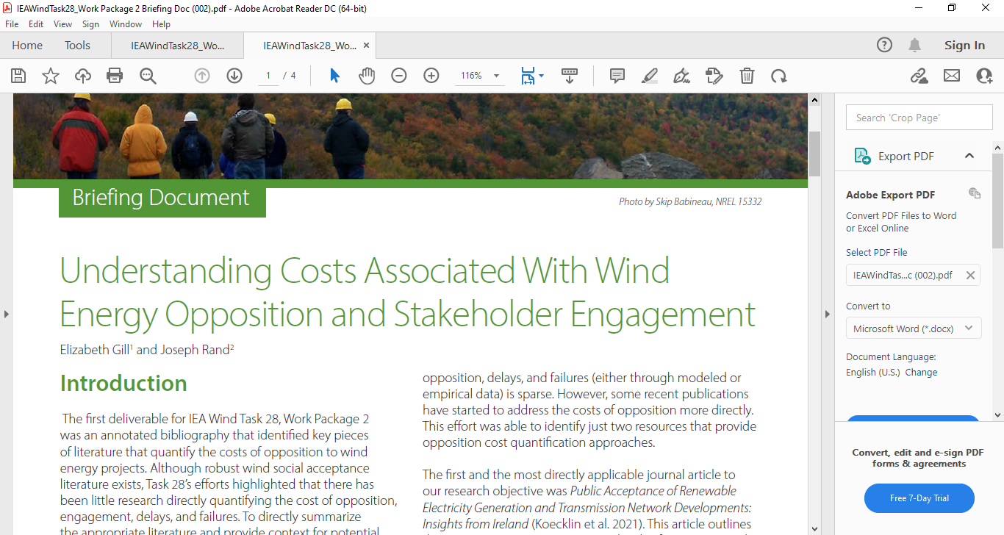
Deliverables and Dissemination
  Work Package 2 Deliverable: Cost of Opposition to Wind Energy Development Briefing Document
Patrick Devine-Wright was Lead Author of the 6th Assessment Report by IPCC Working Group 3, specifically in the chapter on ‘Demand, Services and Social Aspects of Mitigation’ contributing review text on social acceptance of wind energy and public participation in climate mitigation.
Maruyama, Yasushi. 2021. The Governance of Renewable Energy Projects and Expanded Distributive Justice, in Miyauch and Fukunaga eds., Adaptive Participatory Environmental Governance in Japan : Local Experiences, Global Lessons, Springer (book in print).
Keegan, Garry. 2022. Publication of best practice guidelines on Offshore Wind Farm Project Community Acceptance and Stakeholder Engagement, from participating member countries. Disseminated widely by ENTSO (E) and EU Commission and Parliament.
Ocean Power Innovation Network November 2021 Task 28 Presentation on Social Acceptance of Wind Energy.
Task 28 presented at Topical Expert Meeting TEM #103: Offshore Wind Project Consenting, February 2022.
Gundula Huebner (Germany) gave a webinar on the Wind Energy Social Acceptance and Annoyance April 2022.
Task 28 (aligned with WP4) contributing to proposed new TEM on Wind Energy for Emerging Markets (or Economies). Draft ‘Introductory Note’ submitted to Task 11 for consideration. Survey of emerging markets research requirements (Asian, African, Latin American) proposed to inform agenda.

Slide 5
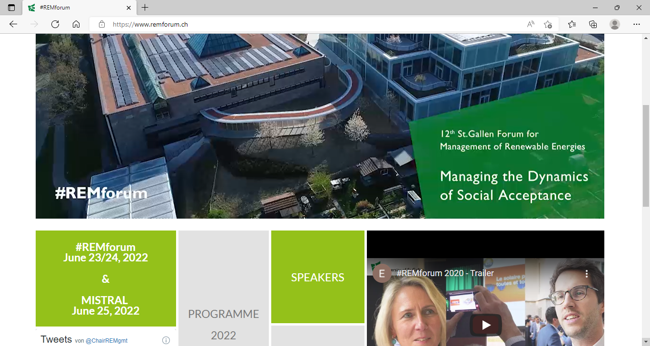
Activity & Industry Involvement
        Industry is involved in Task 28 in every member country.
COP26 Just energy transition: Including citizens and communities in wind power projects - an online event. Glasgow 10 November 2021 (Patrick Devine-Wright from Task 28).
World Wind Energy Conference 2021 Powering the World with Wind and Sun (November 2021) in virtual format with New Delhi. (Patrick Devine-Wright from Task 28).
  C. Mang-Benza, J. Baxter (Task 28 – Canada). Not paid to dance at the powwow: power relations, community benefits, and wind energy in M’Chigeeng First Nation, Ontario, Canada. In Energy Research & Social Science 82, 102301.
Task 28 participation in US DOE Offshore Wind Energy Strategy External Stakeholder Workshops May 2022.
Gundula Huebner (Task 28 – Germany) and others from Denmark and Germany. Annoyance of residents induced by wind turbine obstruction lights: A cross-country comparison of impact factors. Energy Policy Vol 156. September 2021.
John Aston (Ireland) engaged with 7 wind developers and 150 neighbors within 1 km of existing or proposed turbines in 9 counties. The goal was to create the Guide for Earning Local Support for Wind Energy Projects.
Forthcoming: Task 28 Speakers and Meeting - Managing the Dynamics of Social Acceptance. St. Gallen REM Forum 23 June 2022.

Slide 6
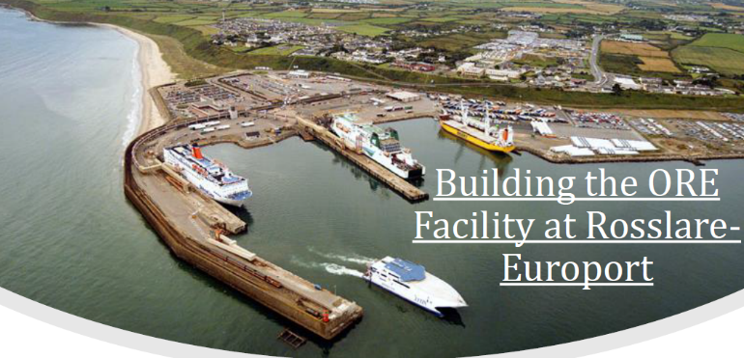
Outreach & Industry Involvement (continued)
UK new Task participant Neil Farrington: (Celtic Sea Power) working closely with the Crown Estate, statutory nature conservation bodies and the Celtic Sea Floating wind developer community to help realize the recently announced intentions for a 4GW floating wind leasing round in the Celtic Sea. Direct industry engagement through Celtic Sea Cluster (https://celticseacluster.com/) and Celtic Sea developer’s alliance.
Task 28 representative in Japan (Yasushi Maruyama) serves as an advisor for Wind Energy Zoning of Municipalities and Prefectures.
In the UK, Task 28 participants with MISTRAL hosted online symposium on social acceptance and the energy transition with 93 attendees.
The U.S. Department of Energy convened developers and academics (including Tegen and Rand) to develop their wind energy stakeholder engagement strategy (2021).
Task 28 liaising with project delivery team on The Future Home of Offshore Wind in Ireland.
Offshore Renewable Energy Hub to facilitate offshore wind deployment of the southeast coast of Ireland. Investment circa +€200m.

Slide 7
Collaboration with other IEA Tasks
Other groups from IEA Wind TCP and elsewhere have reached out to collaborate on knowledge sharing and dissemination. Social acceptance and equity are more important to renewable energy deployment than ever.
TEM #103 February 2022
MISTRAL – training the future social science-renewable energy workforce
Quiet Wind Turbines (Task 39)
Distributed Wind (Task 41)
Airborne Wind (Task 49)
New TEM proposal on WE in Emerging Markets (Task 11)
Task 28’s (WP4) research scope and, by extension, audience, has been limited to the (highly developed global north) countries historically engaged in the Task (e.g., US, EU, Japan). Clean energy is seeing rapid global expansion, and non‐member emerging economies(e.g., in Asia, Africa, and South America) can learn from and offer new insights to the Task. Research into impacts, constraints, and benefits in emerging economies could enable leapfrogging of past mistakes, help reduce global barriers to wind deployment, and offer important insights to industry and policymakers considering wind projects.
Task 28 has reached out to both IEA Hydrogen TCP and the IEA Solar TCP, both have responded favourably so we can soon plan how to move forward in a mutually convenient manner with these.

Slide 8
Administrative Updates
Participation
Participation Changes: Our Joint Operating Agent, Garry Keegan, is stepping down. Task members will vote for the next JOA to work with Suzanne Tegen.
Membership: Japan, Ireland, Germany, USA, Canada, Switzerland, Denmark, Sweden
Observers: France, UK – joining at start of Year 3, the Netherlands, Norway.
Budget
Task Annual Budget: €61,000
Participation Fee (2021/22) €8,000
Overall Budget Status: Down slightly due to smaller contribution from one country (inadvertent country departmental issue)
Work Plan Status (indicate the progress of each work package in work plan)
WP1: 
WP2: 
WP3: 
WP4: 
WP5: 
Task 28 in-person Meeting 23 June 2022 in St. Gallen Institute for Economy and the Environment.

Slide 9
Thank you!
Suzanne.Tegen@colostate.edu
Photo credit: Suisse Eole – Felix Broennimann

