Slide 1
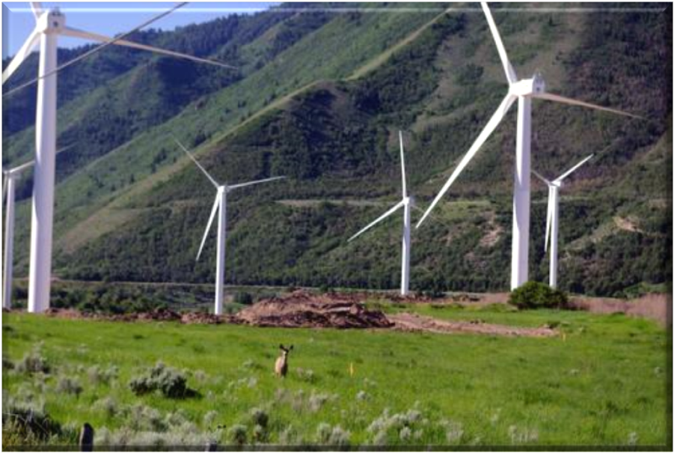
Task 36 Forecasting for Wind Power
Gregor Giebel,
DTU Wind Energy
10 June 2016
Task meeting, Barcelona, ES
Notes:
1

Slide 2
WP0 Management
Tasks:
Task 0.1: Task web site.
Task 0.2: Contractual reporting
Task 0.3: Final report
Deliverables:
D 0.1: Website
D 0.2 – 0.4: Annual reports
D 0.5: Organization of biannual meetings
Notes:
Nothing to be seen here, move on. Website coming up, mostly important for the results we don’t have yet.
2

Slide 3
Country status
Received commitment letters from NO, FI, ES, PT, DK and US. Expected from CN, FR, DE, UK, SE,
Probably AT, BR.
Extended Work Plan approved by ExCo last month, but is missing input from several countries.

Slide 4
Website & Sharepoint

Slide 5
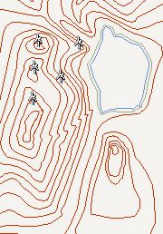
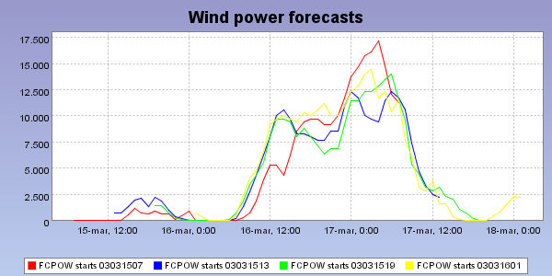
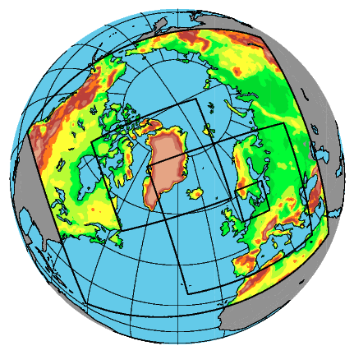
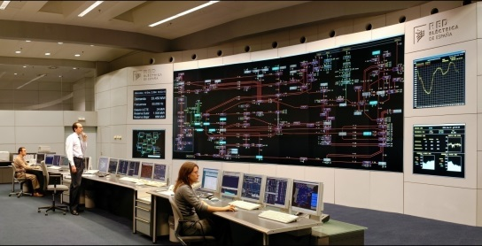
Short-Term Prediction Overview
Orography
Roughness
Wind farm layout
Online data
End user
Numerical Weather Prediction
Prediction model
Notes:
5
Work flow of forecasting models: data from Numerical Weather Prediction (i.e., weather models) is tuned with online power data in the Prediction model itself, and then transported as single (deterministic) forecasts, probabilistic forecasts or scenarios to the end users.

Slide 6
Improvements in NWPs
WP1
Coordination
Datasets
Benchmarks
Orography
Roughness
Wind farm layout
Online data
End user
Numerical Weather Prediction
Prediction model
Notes:
6

Slide 7
WP1 Meteorology
Task 1.1: Compile list of available data sets, especially from tall towers.
Task 1.2: Creation of annual reports documenting and announcing field measurement programs and availability of data.
Task 1.3: Verify and Validate the improvements through a common data set to test model results upon and discuss at IEA Task meetings
Task 1.4: Organization of regular meetings and special sessions at international conferences on
wind energy.

Slide 8
WP1 deliverables
D 1.1: Annual summary of major field studies supportive of wind forecast improvement; list of available data (M12, M24, M36)
D 1.2: Organization of meetings and special sessions at international conferences on wind energy (M6-M36)
D 1.3: Report on future issues for research in wind power prediction (M30)

Slide 9
WP1 Meteorology
Lead:
Helmut Frank, DWD
Joel Cline, DoE
Will Shaw, PNNL

Slide 10
Task 1.1
Compile list of available data sets, especially from tall towers.
Lead: DWD
DE: DWD, ForWind and ZSW will contribute to the compilation of the list of available data sets (0.5 PM each).
DK: All Danish partners will provide input.
US: PNNL will contribute to the compilation, particularly North American data sets (0.5 PM)
Others?

Slide 11
Task 1.2
Creation of annual reports documenting and announcing field measurement programs and availability of data.
DE: As co-leader of WP 1 DWD will also be a leader in the creation of the annual reports (1.5 PM).
US: As co-leader of WP 1, PNNL will also be a leader and primary contributor to reporting (1 PM)
Others?

Slide 12
Task 1.3
Verify and Validate the improvements through a common data set to test model results upon and discuss at IEA Task meetings
Lead: PNNL
DE: DWD will use data from common data sets to verify its models (1.0 PM). ZSW will verify common data sets and resulting improvements for forecasting. This also includes selection of and contribution of different NWP parameter according to forecast skill. (1.5 PM)
DK: VESTAS will verify and validate improved forecasts in several areas and time horizons (short-term, day ahead, seasonal) on a portfolio in VESTAS forecasting system, either using their standard verification tools or implementing new methods as suggested by the IEA Task 36. VESTAS will use met-masts and wind turbine data. The work will be performed in house since the data are highly confidential. Results will be shared and published (1 PM). DMI will verify their model data against a common data set (0.5 PM).
FI: FMI would like to join the verification and validation of model improvements with common data sets within the Nordic regions. The main emphasize is to assess the role of the assimilation of remote sensing data (radar, satellite) within forecast time scales from hours to day ahead (0.75PM).
PT: LNEG will use data assimilation methodologies in particularly to ingest asynoptic data for mesoscale models to provide and validate wind forecasts for short horizon times between (i) 0-3h, (ii) 3-12h and (iii) day ahead for Continental Portugal. The data will be provided from data type sensors such as masts, lidars and nacelle anemometers over an area of study, in particular, at Perdigão test area under the FP7 New European Wind Atlas (NEWA). In this project, a wind campaign to study the wind effects over the stability and surface and low-level jet phenomena will be addressed. (2,0 PM, also for D1.3).
US: PNNL will help identify common data sets for verification and validation and carry out forecast model evaluations within this framework. This is a focus of the U.S. DOE’s Atmospheres to Electrons initiative and has generated candidate data sets such as the Wind Forecast Improvement Projects (WFIPs). [2 PM]

Slide 13
Task 1.4
Organization of regular meetings and special sessions at international conferences on wind energy.
Lead: DTU WE
DE: DWD will participate in the organization of meetings and special sessions (0.5 PM).
DK: DTU Wind Energy will organize 1 session in an International conference as showcase of the Danish way to forecasting high penetration of wind energy, e.g. at the bi-annual International Conference Energy & Meteorology (ICEM), or at one of the European Wind Energy Association ( EWEA) Technical Workshops in wind energy forecasting (1 PM).
US: PNNL will help identify and organize meetings and special sessions on wind power forecasting at international meetings [1 PM]
Shifted to WP0.

Slide 14
Deliverable 1.1
[No more text to the WP1 deliverables than in the intro – skipped for now]

Slide 15
Benchmarks and Error measures
Benchmark Best Practice
Standard evaluation protocol
Benchmarks
WP 2 .
Orography
Roughness
Wind farm layout
Online data
End user
NWP
Prediction model
Notes:
15

Slide 16
Task 2.1 – Lead DTU Elektro
Design of benchmark exercises: best practice
DK: DTU Elektro will be the co-lead of the WP, and lead of the sub-task. They will include design of guidelines for participants and guidelines for reporting results and appraisal (1 PM). WEPROG will add the service provider point of view (0.25 PM).
More industry contribution?

Slide 17
Task 2.2 – Lead DTU Compute / Elektro
Standard evaluation protocol for both deterministic and probabilistic forecasts: review of existing, best practice, and critical assessment of new proposals
DE: ForWind will contribute to the review of existing det. and prob. skill scores and report on postprocessing methods to increase forecast skills. ForWind will characterize NWP model specific ensemble calibrations (0.5PM). IWES will report about German experiments regarding the evaluation of deterministic and probabilistic forecasts that are mainly bases on practical experiences out of the IWES Wind Power Management System and on research within diverse forecasting projects (e.g. EWeLiNE). A focus will lie on the relation between variability and predictability that allows a decomposition oft the wind power forecast quality with a new error metric β providing only model specific error contribution independent from external influences like aggregation effects and local wind speeds. First experiments have shown that the new error metric β has advantages over the common metrics like RMSE, MAE or MAPE. IWES will analyse how the error metric β can be used within the benchmark exercises. (1.5 PM)

Slide 18
Task 2.3 – Lead DTU Wind Energy
Uncovering uncertainty origins and development through the whole modelling chain. Parallels with the Windbench platform.
DE: ForWind will report on uncertainty origins in wind modelling that are uncovered in the EU-Project New European Wind Atlas (NEWA). In particular, advances in uncertainty modelling using Analog Ensemble can be addressed in short-term forecasting and/or wind modelling (1PM). ZSW will assess the uncertainties originate from different NWP models and assess the possibilities to minimize forecast uncertainty by optimal combination of different NWP models (1.5 PM).
DK: DTU Wind Energy will report on the origins of uncertainty in the Numerical Weather Prediction (NWP) part of the chain with focus on Danish cases. We can learn what is important for forecast quality, i.e. chosen metrics for benchmarking from at least two European initiatives: a benchmarking exercise of meso-scale models, coordinated by EWEA and performed by DTU, and the predictability task in the FP7 New European Wind Atlas (NEWA). We can interpret how the benchmarking metrics are associated with the meteorological situation at a given site (0.5 PM).
FI: FMI+VTT will study the forecast uncertainty especially in high resolution day-ahead forecasts. The main focus is to understand the role of inititial/boundary condition errors and forecast model error from the energy production (wind, solar) point of view (0.5+0.25PM).
US: PNNL will apply ensemble techniques to identify sensitivities and uncertainties in the WRF model, particularly with respect to subgrid-scale parameterizations and complex terrain.
http://www.ewea.org/events/workshops/past-workshops/resource-assessment-2015/mesoscale-benchmarking-exercise/

Slide 19
Task 2.4 – Lead DTU Elektro
Set-up and dissemination of benchmark test cases and data sets
DK: DTU Elektro will design the benchmark exercises, collect data from different geographical locations and advertise and disseminate on concept and platform (2 PM). DTU Wind Energy will quality check the Danish data focusing especially on tall towers (0.5 PM).
PT: INESC TEC will help in the design of the benchmark exercises, contact potential suppliers of wind power plant data from Portugal, advertise and disseminate the benchmark platform. INESC TEC is also expecting to participate with their statistical models in the benchmark exercise. (1 PM). Smartwatt will participate contributing with cases and data sets, including NWP forecast, wind power forecast, probabilistic wind power forecast, power and wind measures. (1PM). Prewind will help in the design of the benchmark exercises, to explore different type of terrains, climate effects, etc. Prewind is also available to contribute with recommendations for the wind power forecast evaluation, according with the experience as a service provider (0.5 PM)

Slide 20
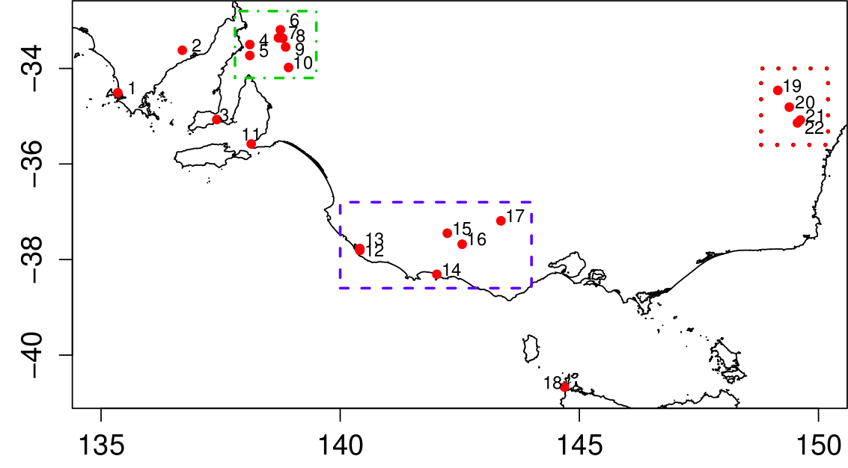
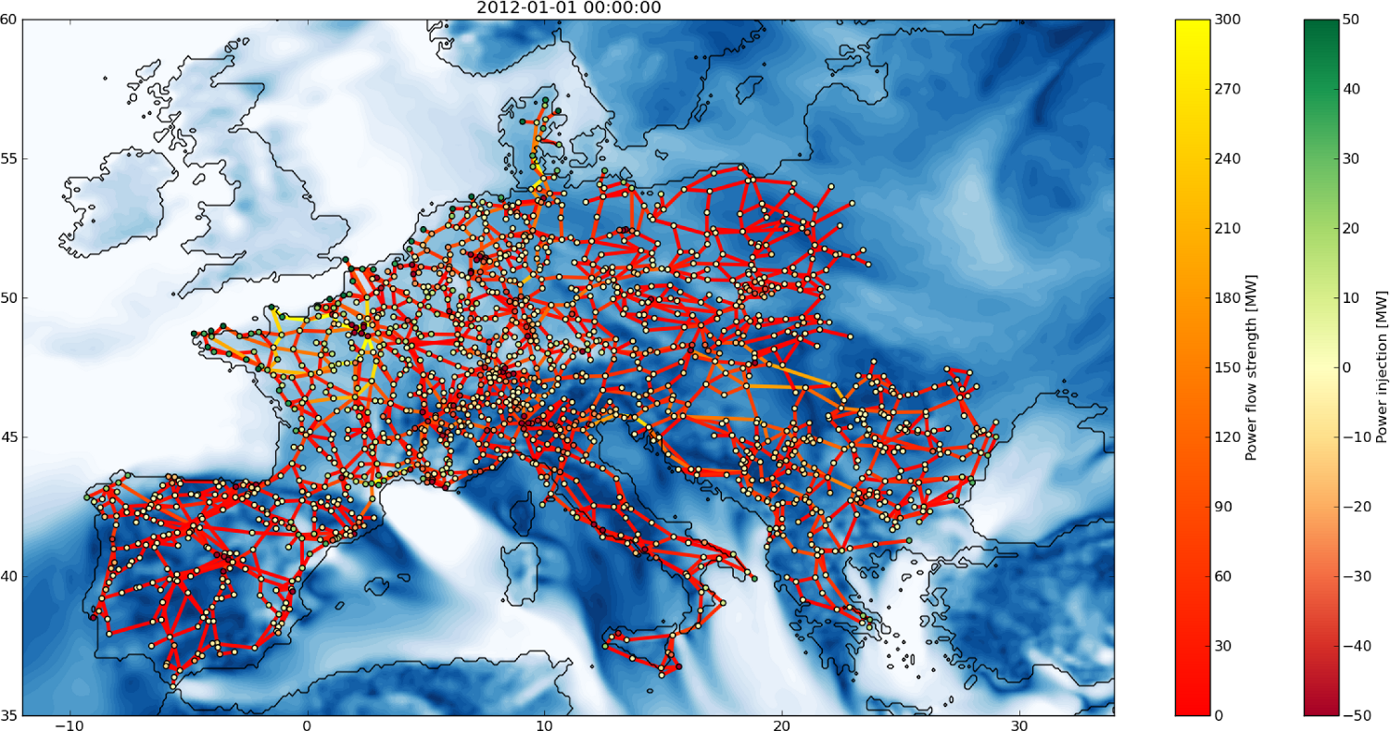
Task 2.4 – Example datasets
AEMO dataset (Australia, 20 wind farms, 5min res. over several years)
RE-Europe (Europe, 1500 nodes with wind and solar power, hourly res. over 3 years – to be extended)

Slide 21
Task 2.4 – What are aiming for?
Long datasets with good resolution
Power and meteorological information (forecasts and possibly measurements, remote sensing)
Preferably more than one location
Possibility to share data, open access or under NDAs
To be hosted on existing platforms e.g. zenodo.org

Slide 22
D2.1
IEA Recommended Practices on Wind Power Forecast Evaluation, for both deterministic and probabilistic forecasts
DK: DTU Compute and DTU Elektro will be lead authors of the IEA Recommended Practices on Wind Power Forecast Evaluation (1.5 and 1 PM).
PT: LNEG can interpret how the benchmarking metrics are associated with the weather conditions at Perdigão test area under NEWA project, or at a given site. (1,5 PM)

Slide 23
D2.2
Forecast data and evaluation protocol implemented and used in WindBench (Task 31)

Slide 24
D2.3
Collection and release of forecast cases for benchmarking and replication studies
PT: LNEG can support the definition of the benchmarking test cases, namely by: i) using an automatic algorithm to detect storm events associated (or not) with wind power ramps; and ii) contacting the wind power producers to provide data for the test cases and also for the dissemination of the results. (2,0 PM)
US: PNNL will submit benchmarking test cases based on data collected during the Wind Forecast Improvement Projects.

Slide 25
Advanced Usage
WP 3
Decision support
Scenarios
Best Practice in Use
Communication
Orography
Roughness
Wind farm layout
Online data
End user
NWP
Prediction model
Notes:
25

Slide 26
WP3 Advanced Usage
Lead:
Georges Kariniotakis, ARMINES – Ecole des Mines
Jens Madsen, Vattenfall

Slide 27
Task 3.1 – Lead: WEPROG
State of the art of use of forecasts uncertainties in the business practices (operation/management, planning of power systems, markets operation/participation) of actors in the power systems sector (TSOs, DSOs, ESCOs, traders etc).
FI: Vaisala interviews several of their end-user clients (0.3 PM).
PT: INESC TEC will support the revision of current practices regarding the use of uncertainty forecasts for grid management at the transmission and distribution level (1 PM). Smartwatt, as a forecast service provider, have practical experience, from the interaction with clients (TSO, DSO, traders), about the real state of usage, barriers and opportunities for probabilistic forecast. This practical experience and information from interaction with users will be a contribution for the elaboration of the state of the art (0.5 PM).

Slide 28
Task 3.2 – Lead: NREL
State of the art and knowledge sharing from demonstration/pilot projects that deal with the use of forecasts in decision making.
DE: ZSW will share experience for forecast usage in different projects currently running (1.0 PM).
PT: INESC TEC will share their knowledge and experience about the development/demonstration of reserve setting tools for interconnected and isolated power systems. Furthermore, the potential application of uncertainty forecasts for the different Portuguese Smart Grid test pilots (InovGrid, FP7 SuSTAINABLE, H2020 SENSIBLE, H2020 UPGRID) will be shared for D3.1 and D3.2 (2 PM). Smartwatt can share experience in cases of real decision making using of probabilistic forecast in risk based generation scheduling (Azores) and cases of probabilistic forecast application in bidding strategies in electricity power markets (Romania) (0.5 PM).

Slide 29
Task 3.3 – Lead: ParisTech
Assessment of the role of short-term forecasting in decision making related to long term (multi annual) processes.
In several projects, e.g. for projection of the power system evolution by 2030/2050 with high shares of renewables, it is necessary to generate multi annual time series that simulate wind power forecast errors with hourly resolution. State of the art, benchmarking, recommended methodology.
FI: VTT will study the usage of short-range and medium-range forecast uncertainties within the energy system modelling framework. Also the effects of forecast errors to power system balance on different time scales will be studied and the impacts of forecast errors on long term investments in power systems (0.3 PM). Vaisala will bring forward their experience with large scale integration studies (0.3 PM).
PT: INESC TEC will share their experience and define recommendations for mid and long-term wind power time series to be integrated in static/operating reserve adequacy studies (1 PM).
US: NREL will contribute to the task.
Matos, M., Lopes, J. P., Rosa, M., Ferreira, R., da Silva, A. L., Sales, W., et al. (2009). Probabilistic evaluation of reserve requirements of generating systems with renewable power sources: The Portuguese and Spanish cases. International Journal of Electrical Power & Energy Systems, 31(9), 562-569.

Slide 30
Task 3.4 – Lead: NREL
Review of existing/proposal of best practices on how to measure/quantify the value from the use of probabilistic forecasts
FI: VTT will discuss with end-users and system operators how the uncertainty has been incorporated in their daily operation and review on the needs of end-users and system operators (0.2 PM). Vaisala interviews several of their end-user clients (0.3 PM).
PT: INESC TEC will contribute to the definition of metrics to measure the quality of decisions and value of forecasting in several problems, such as operating reserve setting and wind power market bidding (2 PM).
US: NREL will contribute to the task.

Slide 31
Task 3.5 – Lead: INESC TEC
Communication of wind and wind power forecasts to end-users. Review, recommendations/best practice. Is it necessary to standardise wind power forecasting products?
DK: DTU Wind Energy will organise a Danish workshop with end users on how to ideally communicate best practices to and how to motivate the private sector to implement new breakthroughs in forecasting wind energy in their system (0.5 PM).
PT: INESC TEC will propose recommendations about how to communicate wind power uncertainty to different TSO and DSO related problems, such as reserves setting and voltage control in distribution networks (2 PM). Smartwatt, as wind power forecast provider, have strong experience on forecast delivery and web platform design and development. Smartwatt could contribute with the own experience and product and with the perception of requirement and satisfaction from client perspective (0.5 PM). Prewind is available to contribute with the experience as a service provider to propose recommendations about how to communicate wind and wind power forecast to end users (0.5 PM).
US: NREL will contribute to the task.

Slide 32
Task 3.6 – Lead: Smartwatt?
Set up data sets for benchmarking on the value from the use of forecasts, i.e., for trading.
PT: INESC TEC will contribute to the definition of the benchmarking exercise, such as metrics definition, collection of data (1 PM). Smartwatt could contribute with data sets for benchmarking on the value from the use of forecasts, for risk based scheduling problem (Azores) and for trading case in (Romania) (0.5 PM). Prewind is available to contribute with the experience as a service provider to help in the design of the benchmark exercises, to explore different type of terrains, climate effects, etc. (0.5 PM).

Slide 33
D3.1
Report on use cases for probabilistic forecasts and scenarios, including the optimal uncertainty measure and evaluation protocol
DE: IWES will share information about the actual situation, barriers, challenges and potentials of probabilistic wind power forecasts in Germany. The main focus will lie on probabilistic forecasts for grid control. (1PM)
DK: All Danish partners will contribute writing a report and present results within a special session at an International conference as showcase of the Danish way to best integrating public and private sector. A catalogue will be generated try to quantify how reliable forecasts are used in various business areas of the Danish power industry for decision making (ENFOR 0.75 PM, Vestas 0.5 PM, Energinet.dk 1 PM).
PT: Based on the NWP outputs, LNEG pretends to apply a weather circulation classification (principal component analysis coupled with clustering techniques) to identify in a probabilistic way, periods associated with wind power ramp events (1 PM).

Slide 34
D3.2
Position paper regarding the use of probabilistic forecasts (based on tasks 3.1 and 3.2, addressed to higher level management)
DK: WEPROG will lead the writing of a chapter regarding Danish status and future perspectives of the Danish Industry need (1.25 PM).
PT: LNEG pretends to follow closely the work developed in these tasks providing when possible contributions based on our knowledge/experience (2 PM).

Slide 35
D3.3
Webinars to inform users about outcomes of tasks 3.3 – 3.6
DK: DTU Wind Energy will organise webinars regarding the IEA Task outcomes, including one in Danish language (0.5 PM).

Slide 36
AOB
Next meetings: 22-26 January 2017, special session at AMS Seattle (+meeting) (Abstract deadline 1 August)
EWEA Hamburg, short meeting for the people who are there anyway
Task meetings on web platform.
Task / WP Leader meeting soon (GG Doodle).
26 June 2017, Wind Power Science conf in Lyngby
Or PowerTech? Manchester. Special session? June.
Or ARMINES Paris or Sophia Antipolis. Or Lyon. Or Porto.
Q&A?

Slide 37
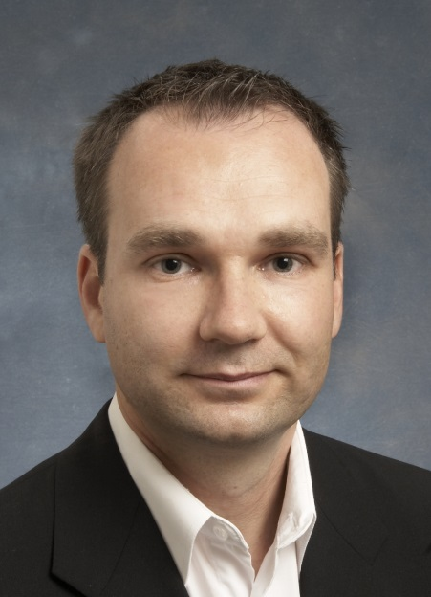
Thank You!!
Gregor Giebel
DTU Wind Energy, Frederiksborgvej 399, DK-4000 Risø
grgi@dtu.dk
Cell: +45 4056 5095
The IEA Wind agreement, also known as the Implementing Agreement for Co-operation in the Research, Development, and Deployment of Wind Energy Systems, functions within a framework created by the International Energy Agency (IEA). Views, findings, and publications of IEA Wind do not necessarily represent the views or policies of the IEA Secretariat or of all its individual member countries.

